Slide 1
Incorporating Humor into Writing
C. Randall Nicholson
With Special Guest Star Douglas Adams

Slide 2
Reasons to Incorporate Humor
Comic Relief – to reduce tension in an otherwise serious, dark, or scary story
Satire – to get “deep” messages across in a less preachy way
Entertainment – believe it or not, this is a good enough reason on its own

Slide 3
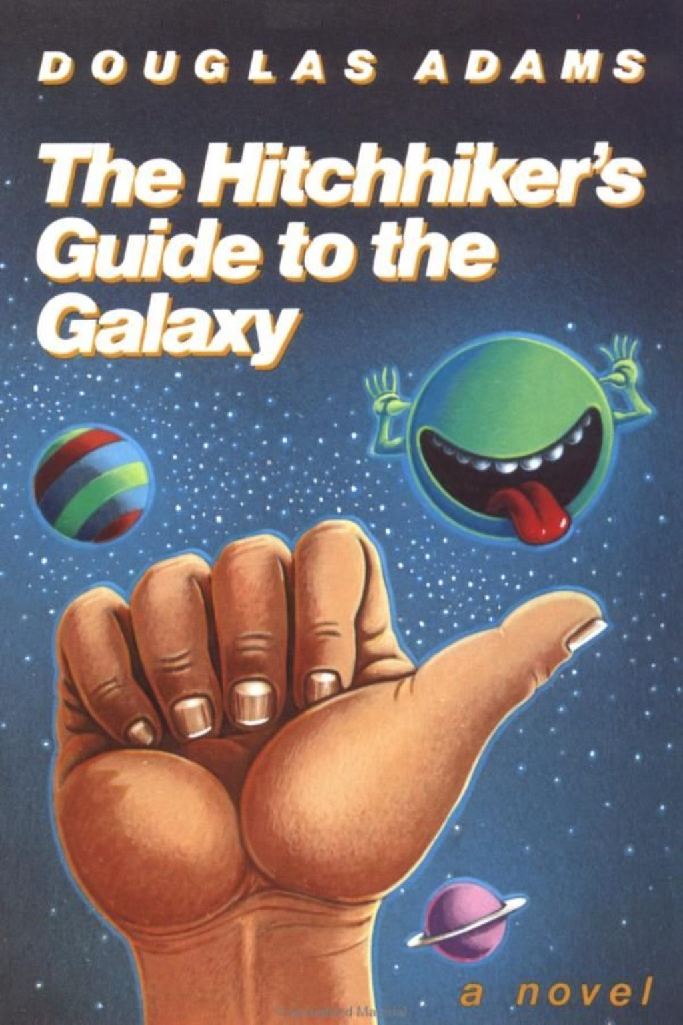
Ways to Incorporate Humor
Using Examples from Douglas Adams’ The Hitchhiker’s Guide to the Galaxy series

Slide 4
Fresh Perspectives on Familiar Things
Far out in the uncharted backwaters of the unfashionable end of the Western Spiral arm of the Galaxy lies a small unregarded yellow sun.
Orbiting this at a distance of roughly ninety-two million miles is an utterly insignificant little blue-green planet whose ape-descended life forms are so amazingly primitive that they still think digital watches are a pretty neat idea.
This planet has—or rather had—a problem, which was this: most of the people on it were unhappy for pretty much of the time. Many solutions were suggested for this problem, but most of these were largely concerned with the movements of small green pieces of paper, which is odd because on the whole it wasn’t the small green pieces of paper that were unhappy.
And so the problem remained; lots of the people were mean, and most of them were miserable, even the ones with digital watches.
Many were increasingly of the opinion that they’d all made a big mistake in coming down from the trees in the first place. And some said that even the trees had been a bad move, and that no one should ever have left the oceans.
And then, one Thursday, nearly two thousand years after one man had been nailed to a tree for saying how great it would be to be nice to people for a change, one girl sitting on her own in a small cafe in Rickmansworth suddenly realized what it was that had been going wrong all this time, and she finally knew how the world could be made a good and happy place. This time it was right, it would work, and no one would have to get nailed to anything.

Slide 5
Exaggeration
[Vogons] are one of the most unpleasant races in the Galaxy – not actually evil, but bad tempered, bureaucratic, officious and callous. They wouldn’t even lift a finger to save their own grandmothers from the Ravenous Bugblatter Beast of Traal without orders signed in triplicate, sent in, sent back, queried, lost, found, subjected to public inquiry, lost again, and finally buried in soft peat and recycled as firelighters.
The best way to get a drink out of a Vogon is to stick your finger down his throat, and the best way to irritate him is to feed his grandmother to the Ravenous Bugblatter Beast of Traal.

Slide 6
Subverting Expectations
“You know,” said Arthur, “it’s at times like this, when I’m trapped in a Vogon airlock with a man from Betelgeuse, and about to die of asphyxiation in deep space that I really wish I’d listened to what my mother told me when I was young.”
“Why, what did she tell you?”
“I don’t know, I didn’t listen.”

Slide 7
Unusual Juxtaposition
"This is futile," he exclaimed, "five hundred and seventy-three committee meetings and you haven't even discovered fire yet!“
"If you would care," said the girl with the strident voice, "to examine the agenda sheet..."
"Agenda rock," trilled the hairdresser happily.
"Thank you, I've made that point," muttered Ford.
"... you ... will ... see ..." continued the girl firmly, "that we are having a report from the hairdressers' Fire Development Sub-Committee today." [...]
"Never mind," said Ford, "Rome wasn't burnt in a day."
The crowd hadn't the faintest idea what he was talking about, but they loved it nevertheless. They applauded.
"Well, you're obviously being totally naive of course," said the girl, "When you've been in marketing as long as I have you'll know that before any new product can be developed it has to be properly researched. We've got to find out what people want from fire, how they relate to it, what sort of image it has for them.“
The crowd were tense. They were expecting something wonderful from Ford.
"Stick it up your nose," he said.
"Which is precisely the sort of thing we need to know," insisted the girl, "Do people want fire that can be applied nasally?”

Slide 8
Wordplay
“No, don’t move,” [Ford] added as Arthur began to uncurl himself, “you’d better be prepared for the jump into hyperspace. It’s unpleasantly like being drunk.”
“What’s so unpleasant about being drunk?”
“You ask a glass of water.”

Slide 9
Repetition
A tall figure appeared silhouetted in the hatchway. It walked down the ramp and stood in front of Arthur.
“You’re a jerk, Dent,” it said simply.[...]
The alien creature frowned briefly and consulted what appeared to be some species of clipboard which he was holding in his thin and spindly alien hand. “Arthur Dent?” it said.
Arthur nodded helplessly.[...]
“You’re a jerk,” repeated the alien, “a complete kneebiter.”
[Later]
“What’s your name?”
“Dent,” said Arthur, “Arthur Dent.”
“You’re a jerk, Dent,” said the boy, “a complete kneebiter.”
[Just a little later]
“Arthur Philip Deodat?” asked the figure.
The man, with horrified confusion in eyes, nodded feebly.
“You’re a no-good dumbo nothing,” whispered the creature. “I thought you should know that before you went.”
[Much later]
A hatchway opened, a ramp extended, and a tall grey-green alien marched out and approached him.
“Arthur Phili...” it said, then glanced sharply at him and down at his clipboard. He frowned. He looked up at him again.
“I’ve done you before, haven’t I?” he said.

Slide 10
Absurdity
The deadly missile attack shortly to be launched by an ancient automatic defence system will result merely in the breakage of three coffee cups and a micecage, the bruising of somebody’s upper arm, and the untimely creation and sudden demise of a bowl of petunias and an innocent sperm whale.

Slide 11
Making Characters Suffer
“Look,” said Arthur, “would it save you a lot of time if I just gave up and went mad now?”

Slide 12
Dark Humor – Really Making Characters Suffer
“Sorry, did I say something wrong?” said Marvin, dragging himself on regardless. “Pardon me for breathing, which I never do anyway so I don’t know why I bother to say it, oh God I’m so depressed. Here’s another of those self-satisfied doors. Life! Don’t talk to me about life.”

Slide 13
Inherently Funny Characters
One of the major difficulties Trillian experienced in her relationship with Zaphod was learning to distinguish between him pretending to be stupid just to get people off their guard, pretending to be stupid because he couldn’t be bothered to think and wanted someone else to do it for him, pretending to be outrageously stupid to hide the fact that he actually didn’t understand what was going on, and really being genuinely stupid. He was renowned for being amazingly clever and quite clearly was so – but not all the time, which obviously worried him, hence the act. He prefered people to be puzzled rather than contemptuous. This above all appeared to Trillian to be genuinely stupid, but she could no longer be bothered to argue about it.

